Slide 1

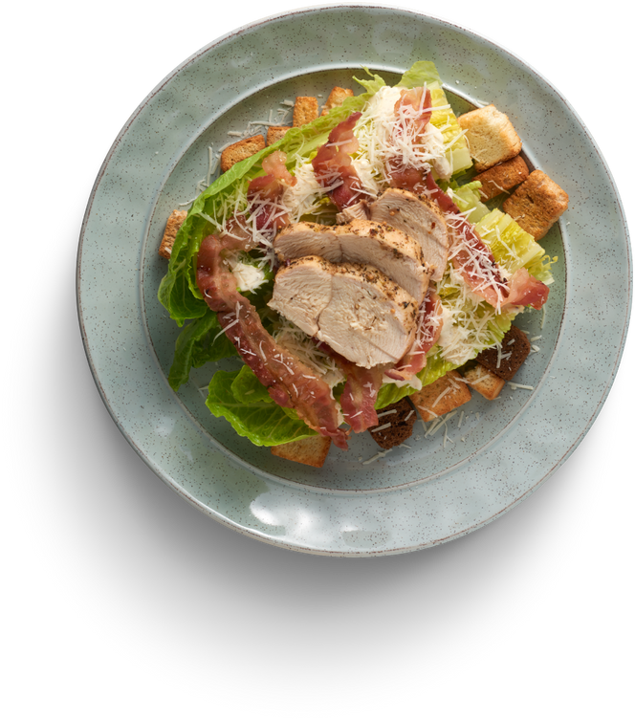
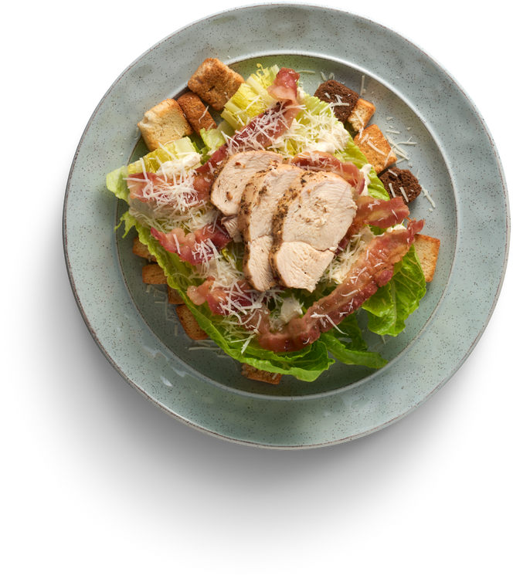







View Menu
FRESH
CONNECT
Connect With Food
We are what we eat
FRESH CONNECT
4,0

Slide 2



VIVEKANAND COLLEGE FOR ADVANCE COMPUTER AND INFORMATION SCIENCE,SURAT.
FRESH CONNECT
Submitted By:
GUIDED BY :
Aman Patel
Bhavika Patel
Rutvesh Upale
Vivek Ghantiwala
Mrs. Nidhi Mehta

Slide 3



INDEX
 | Sr No.
Sr.No
Topic
1.
Project Profile
2.
Project Introduction
3.
Project Objectives
4.
Scope
5.
Environment Description
6.
UML Diagram(UseCaseDiagrm)
7.
Collections
8.
Screenshot
9.
Refrence

Slide 4






PROJECT PROFILE
 | Sr No.
Title
Fresh Connect
Front end tools
React
Back end tools
Mongodb , Node.js , Express.js
Guided by
Ms. Nidhi Mehta
Submitted by
Aman Patel
Bhavika Patel
Rutvesh Upale
Vivek Ghantiwala

Slide 5


INTRODUCTION
Fresh Connect is an innovative digital marketplace revolutionizing how we handle near-expiring food
The platform bridges sellers with excess inventory and buyers seeking affordable quality food
Vegetable vendors can sell produce 1-2 days from expiration at discounted rates.
Restaurant owners can list surplus food at reduced prices, converting waste into revenue.

Slide 6
Our user-friendly interface allows easy inventory management and competitive pricing.
Buyers discover great deals on fresh produce and restaurant-quality food.
Features include real-time updates, secure payments, and location-based search
We help sellers recover costs while making quality food accessible to price-conscious consumers.
Our goal is creating a sustainable ecosystem minimizing food waste.
Join us in making a difference, one connection at a time Mission.

Slide 7
OBJECTIVES
Create a digital marketplace connecting near-expiring produce/restaurant surplus sellers with buyers.
Reduce food waste by providing alternatives to discarding
usable food.
Offer sellers a platform to recover costs from would-be wasted inventory.
Provide consumers access to quality food at reduced prices.

Slide 8
Help sellers reduce waste and recover costs.
Enable buyers to access quality food at lower prices.
Benefit the environment through reduced food waste Objectives
Create a digital marketplace connecting near-expiring produce/restaurant surplus sellers with buyers.
Reduce food waste by providing alternatives to discarding usable food.
Provide consumers access to quality food at reduced prices.
Develop an intuitive, user-friendly interface for all users.
Implement secure transaction processing and inventory management tools.

Slide 9





SCOPE
END USER
SELLER
RESTAURANT
ADMIN

Slide 10


End User
Browse all products
Filter by location/price
Place orders
Track order status
Rate sellers/products
Receive deal notifications
Save favorite sellers
Manage profile
Contact sellers
Set preferences

Slide 11
Seller
Create vendor profile
Add vegetable products
Upload product images
Update inventory
Set delivery options
Track sales performance
Communicate with buyers
View order history
Set discount schedules
Receive payments
Receive payments

Slide 12
Restaurant
Create restaurant profile
Add leftover food listings
Upload food images
Set pickup locations
Track order history
Modify food listings
Communicate with buyers
Set time-based discounts
Receive payments
View customer ratings
Access sales metrics

Slide 13
Admin
Approve seller registrations
Monitor platform activity
Manage user accounts
View analytics
Implement system updates
Feature sellers/products
Send notifications
Enforce quality standards
Access financial reports
Remove inappropriate content
Manage platform fees

Slide 14

ENVIRONMENT DESCRIPTION
Hardware / Software Requirement
Tools & Technology Used

Slide 15
HARDWARE REQUIREMENT
Hardware Requirement
Processer
Core i5
RAM
8 GB RAM
Hard-Disk
256 GB SSD

Slide 16
SOFTWARE REQUIREMENT
Hardware Requirement
Processer
Core i5
RAM
8 GB RAM
Hard-Disk
256 GB SSD

Slide 17
UML DIAGRAM (USE-CASE)
End User
Seller
Restaurant
Admin

Slide 18



End User

Slide 19
Seller
Create profile
Add products
Seller
Upload images
Update inventory

Slide 20
Restaurant
Create profile,Add leftovers
Upload images,Set pickup
Restaurantr
Track orders,Modify listings
Message buyers,Set discounts
Receive payments,View ratings
Access metrics

Slide 21
Admin
Approve registrations
Monitor activity,Manage accounts
Admi
View analytics,Update system
Feature sellers,Send notifications
Enforce standards,Access reports
Remove content,Manage fees

Slide 22

COLLECTIONS
Carts
Inventories
Feedbacks
Menuitems
Hotels
Orders
Imagestorages
Products

Slide 23
Purchases
Reviews
Urgentsales
Users
Wishlists

Slide 24
End User
Field
Datatype
Constraints
Description
_id
Object
Primary Key
Indicates User ID.
name
String
Required
Stores the full name of the user.
email
String
Required, Unique
Stores the email address of the user.
password
String
Required
Stores the hashed password for authentication.
phone
String
Optional
Stores the contact phone number of the user.
role
String
Required
Indicates the role of the user (e.g., admin,user).
isVerified
Boolean
Default: false
Indicates whether the user's email is verified.
documents
Object
Optional
Stores references to user-related documents.
createdAt
Object
Required
Stores the timestamp when the user was created.
updatedAt
Object
Required
Stores the timestamp when the user was last updated.
__v
Number
System Field
Stores the versioning field managed by MongoDB.

Slide 25
Products
Field
Datatype
Constraints
Description
_id
Object
Primary Key
Indicates Product ID.
name
String
Required
Stores the product name.
imageUrl
String
Optional
Stores the URL of the product image.
price
Number
Required
Stores the product price.
category
String
Required
Indicates the category ID of the product.
inStock
Boolean
Default: true
Indicates if the product is available in stock.
description
String
Optional
Stores the description of the product.
__v
Number
System Field
Stores the versioning field managed by MongoDB.
createdAt
Object
Required
Stores the timestamp when the product was created.
discount
Number
Optional
Stores the discount percentage on the product.
image
String
Optional
Stores the image of the product.

Slide 26
isFresh
Boolean
Default:false
Indicates if the product is fresh.
isOrganic
Boolean
Default: false
Indicates if the product is organic.
isVerified
Boolean
Default: false
Indicates if the product is verified.
numReviews
Number
Default: 0
Stores the total number of reviews.
rating
Number
Default: 0
Stores the average rating of the product.
reviews
Object
Optional
Stores the customer reviews for the product.
seller
Object
Required
Stores the seller's details or reference.
sellerType
String
Required
Indicates the type of seller (e.g., individual, business).
stock
Number
Required
Stores the total stock quantity available.
unit
String
Required
Stores the measurement unit of the product (e.g., kg, liter).
updatedAt
Object
Required
Stores the timestamp when the product was lastupdated
urgentSale
Boolean
Default: false
Indicates if the product is on urgent sale.

Slide 27
Urgent Sales
Field
Datatype
Constraints
Description
_id
Object
Primary Key
Indicates Urgent Sale ID.
seller
Object
Required
Stores the seller's details or reference.
product
Object
Required
Stores the product details or reference.
name
String
Required
Stores the name of the urgent sale product.
originalPrice
Number
Required
Stores the original price of the product..
discountedPric
Number
Required
Stores the discounted price of the product.
stock
Number
Required
Stores the available stock quantity.
unit
String
Required
Stores the measurement unit (e.g., kg, liter).
expiryDate
Object
Required
Stores the expiry date of the urgent sale offer.
descriptio
Object
Optional
Stores the description of the urgent sale item.
image
String
Optional
Stores the image of the product.

Slide 28
isActive
Boolean
Default: true
Indicates if the urgent sale is active.
createdAt
Object
Required
Stores the timestamp when the urgent sale was created.
updatedAt
Object
Required
Stores the timestamp when the urgent sale was last updated.
__v
Number
System Field
Stores the versioning field managed by MongoDB.

Slide 29
MenuItem
Field
Datatype
Constraints
Description
_id
Object
Primary Key
Indicates Menu Item ID.
hotel
Object
Required
Stores the reference to the hotel or restaurant.
name
String
Required
Stores the name of the menu item.
description
String
Optional
Stores the description of the menu item.
price
Number
Required
Stores the price of the menu item...
image
String
Optional
Stores the image URL of the menu item.
category
String
Required
Indicates the category of the menu item.
isVegetariant
Boolean
Default: false
Indicates if the menu item is vegetarian.
isVegan
Boolean
Default: false
Indicates if the menu item is vegan.
isGlutenFree
Boolean
Default: false
Indicates if the menu item is gluten-free.
isAvailable
Boolean
Default: false
Indicates if the menu item is available.

Slide 30
ingredients
Object
Optional
Stores the list of ingredients used.
preparationTime
Number
Required
Stores the preparation time in minutes.
isPopular
Boolean
Default: false
Indicates if the menu item is popular.
rating
Number
Default: 0
Stores the average rating of the menu item..
numReviews
Number
Default: 0
Stores the total number of reviews.
createdAt
Object
Required
Stores the timestamp when the menu item was created.
updatedAt
Object
Required
Stores the timestamp when the menu item was last updated.
__v
Number
System Field
Stores the versioning field managed by MongoDB.

Slide 31
Purchase
Field
Datatype
Constraints
Description
_id
Object
Primary Key
Indicates Purchase ID.
user
Object
Required
Stores the reference to the user who made the purchase.
hotel
Object
Required
Stores the reference to the hotel associated with the purchas.
supplier
String
Required
Stores the name of the supplier.
items
Object
Required
Stores the list of purchased items.
totalAmount
Number
Requiredl
Stores the total amount of the purchase.
paymentMethod
String
Required
Stores the payment method used (e.g., cash, card).
paymentStatus
String
Default: false
Indicates the status of the payment (e.g., pending, completed)
notes
String
Optional
Stores any additional notes about the purchase.
receiptNumber
String
Required
Stores the unique receipt number for the purchase.
createdAt
Object
Required
Stores the timestamp when the purchase was made.
updatedAt
Object
Required
Stores the timestamp when the purchase was last updated.

Slide 32
Inventories
Field
Datatype
Constraints
Description
_id
Object
Primary Key
Indicates Inventory ID.
hotel
Object
Required
Stores the reference to the hotel.
name
String
Required
Stores the name of the inventory item.
category
String
Required
Indicates the category of the inventory item.
quantity
Number
Required
Stores the quantity available in stock.
unit
String
Required
Stores the measurement unit (e.g., kg, liter).
price
Number
Required
Stores the price of the inventory item.
supplier
Object
Required
Stores the reference to the supplier.
purchaseDate
Object
Required
Stores the date when the item was purchased.
minStockLevel
Number
Required
Stores the minimum stock level before alert.
isLowStock
Boolean
Default: false
Indicates if the stock is below the minimum level.

Slide 33
isOutOfStoc
Boolean
Default: false
Indicates if the inventory item is out of stock.
location
String
Optional
Stores the storage location of the inventory item.
notes
String
Optional
Stores additional notes about the inventory item.
images
Object
Optional
Stores image references of the inventory item.
isLeftoverFood
Boolean
Default: false
Indicates if the item is leftover food.
createdAt
Object
Required
Stores the timestamp when the menu item was created.
updatedAt
Object
Required
Stores the timestamp when the menu item was last updated.
__v
Number
System Field
Stores the versioning field managed by MongoDB.

Slide 34
Tasks
Field
Datatype
Constraints
Description
_id
Object
Primary Key
Indicates Inventory ID.
hotel
Object
Required
Stores the reference to the hotel.
title
String
Required
Stores the name of the inventory item.
description
String
Required
Indicates the category of the inventory item.
status
String
Required
Stores the quantity available in stock.
priority
String
Required
Stores the measurement unit (e.g., kg, liter).
dueDate
Object
Required
Stores the price of the inventory item.
assignedTo
String
Required
Stores the reference to the supplier.
category
String
Optional
Stores the date when the item was purchased.
progress
Number
Default: 0
Stores the minimum stock level before alert.
notes
Stringn
Optional
Indicates if the stock is below the minimum level.

Slide 35
attachments
Object
Optional
Indicates if the inventory item is out of stock.
createdAt
Object
Required
Stores the timestamp when the inventory item was created.
updatedAt
Object
Required
Stores the timestamp when the inventory item was last update.
__v
Number
System Field
Stores the versioning field managed by MongoDB.

Slide 36
Hotels
Field
Datatype
Constraints
Description
_id
Object
Primary Key
Indicates Hotel ID.
name
Object
Required
Stores the name of the hotel.
email
String
Required
Stores the hotel's email address.
password
String
Required
Stores the hashed password for authentication.
address
String
Required
Stores the hotel’s address details.
phone
String
Required
Stores the hotel's contact phone number.
description
Object
Required
Stores a brief description of the hotel.
logo
String
Required
Stores the URL of the hotel’s logo image.
coverImage
String
Optional
Stores the URL of the hotel’s cover image.
isVerified
Number
Default: 0
Indicates whether the hotel is verified.
rating
Stringn
Optional
Stores the average rating of the hotel..

Slide 37
numReviews
Object
Optional
Stores the total number of reviews.
verificationDoc
Number
Required
Stores references to verification documents.
reviews
Object
Default: false
Stores customer reviews for the hotel.
updatedAt
Object
Required
Stores the timestamp when the hotel was last updated.
createdAt
Object
Required
Stores the timestamp when the hotel was created.
__v
Number
System Field
Stores the versioning field managed by MongoDB.
isHotel
Boolean
Default: true
Indicates whether the entity is a hotel.
role
String
Required
Indicates the role of the hotel in the system.

Slide 38
ImagesStorage
Field
Datatype
Constraints
Description
_id
Object
Primary Key
Indicates Image Storage ID.
data
Object
Required
Stores the binary data of the image.
contentType
String
Required
Stores the MIME type of the image (e.g., image/png,).
filename
String
Required
Stores the original name of the uploaded file.
user
Object
Required
Stores the reference to the user who uploaded the image.
storageType
String
Required
Indicates the type of storage used (e.g., local, cloud).
uploadDate
Object
Required
Stores the timestamp when the image was uploaded.
__v
Number
System Field
Stores the versioning field managed by MongoDB.

Slide 39
FeedBacks
Field
Datatype
Constraints
Description
_id
Object
Primary Key
Indicates Feedback ID.
user
Object
Required
Stores the reference to the user who provided the feedback.
rating
Number
Required
Stores the rating given by the user (e.g., 1-5).
comment
String
Optional
Stores the user's feedback comment.
createdAt
Object
Required
Stores the timestamp when the feedback was submitted.
status
String
Default: "pending"
Indicates the feedback status (e.g., pending, reviewed).
response
Object
Optional
Stores the response to the feedback from the hotel or admin.
hotel
Object
Required
Stores the reference to the hotel associated with the feedback.

Slide 40
Orders
Field
Datatype
Constraints
Description
_id
Object
Primary Key
Indicates Order ID.
buyer
Object
Required
Stores the reference to the user who placed the order.
items
String
Required
Stores the list of ordered items.
shippingAddress
String
Required
Stores the shipping address details.
totalAmount
String
Required
Stores the total order amount.
status
String
Default: "pending"
Indicates the current order status (e.g., pending, shipped).
paymentMethod
Object
Required
Stores the payment method (e.g., cash, credit card).
paymentStatus
String
Default: "unpaid"
Indicates the payment status (e.g., unpaid, paid, refunded
createdAt
Object
Required
Stores the timestamp when the order was created.
updatedAt
Object
Required
Stores the timestamp when the order was last updated.
seller
Object
Required
Stores the reference to the seller processing the order.

Slide 41


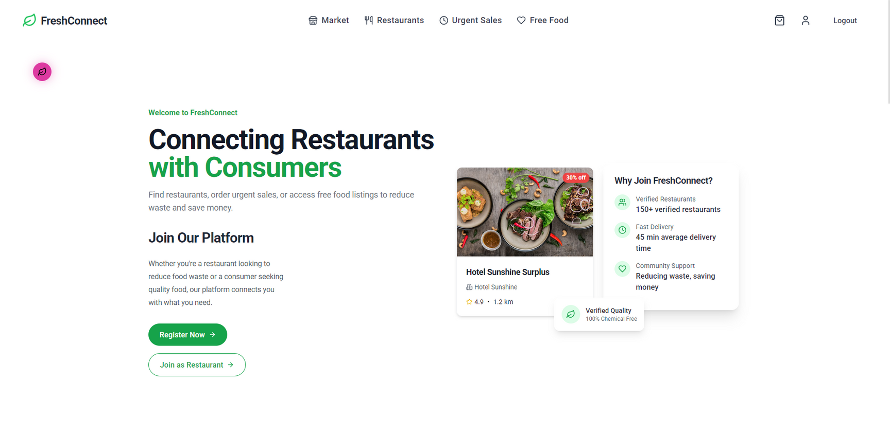


Slide 42
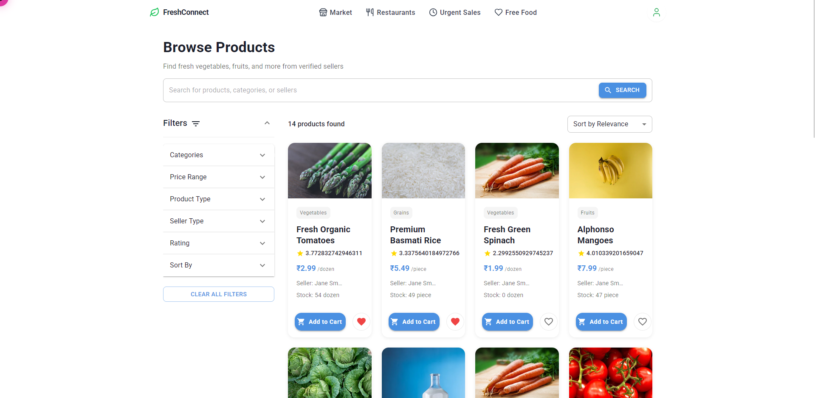

Slide 43
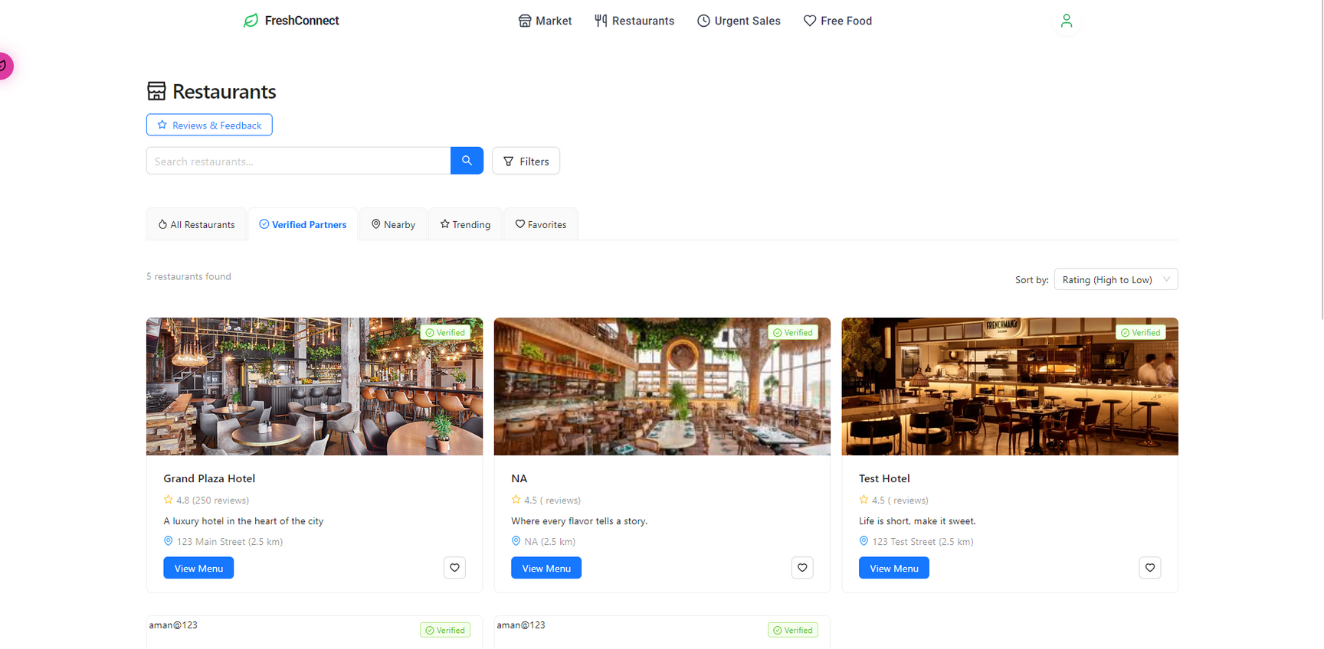

Slide 44
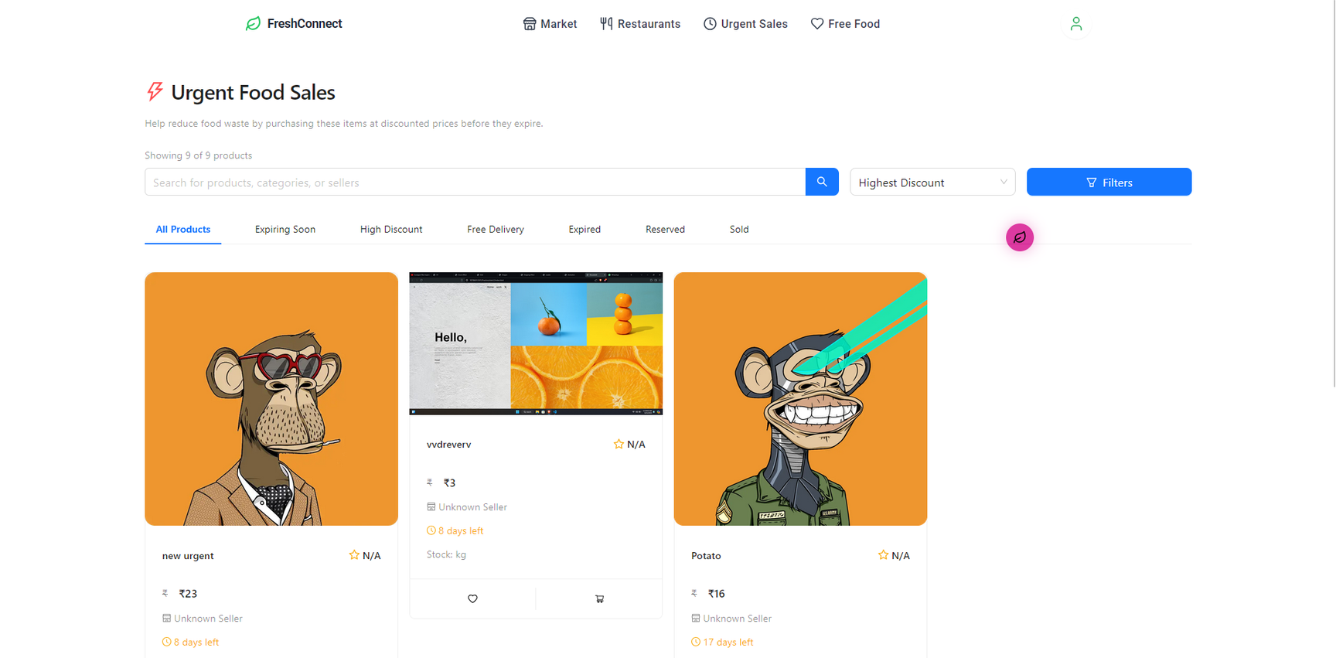

Slide 45
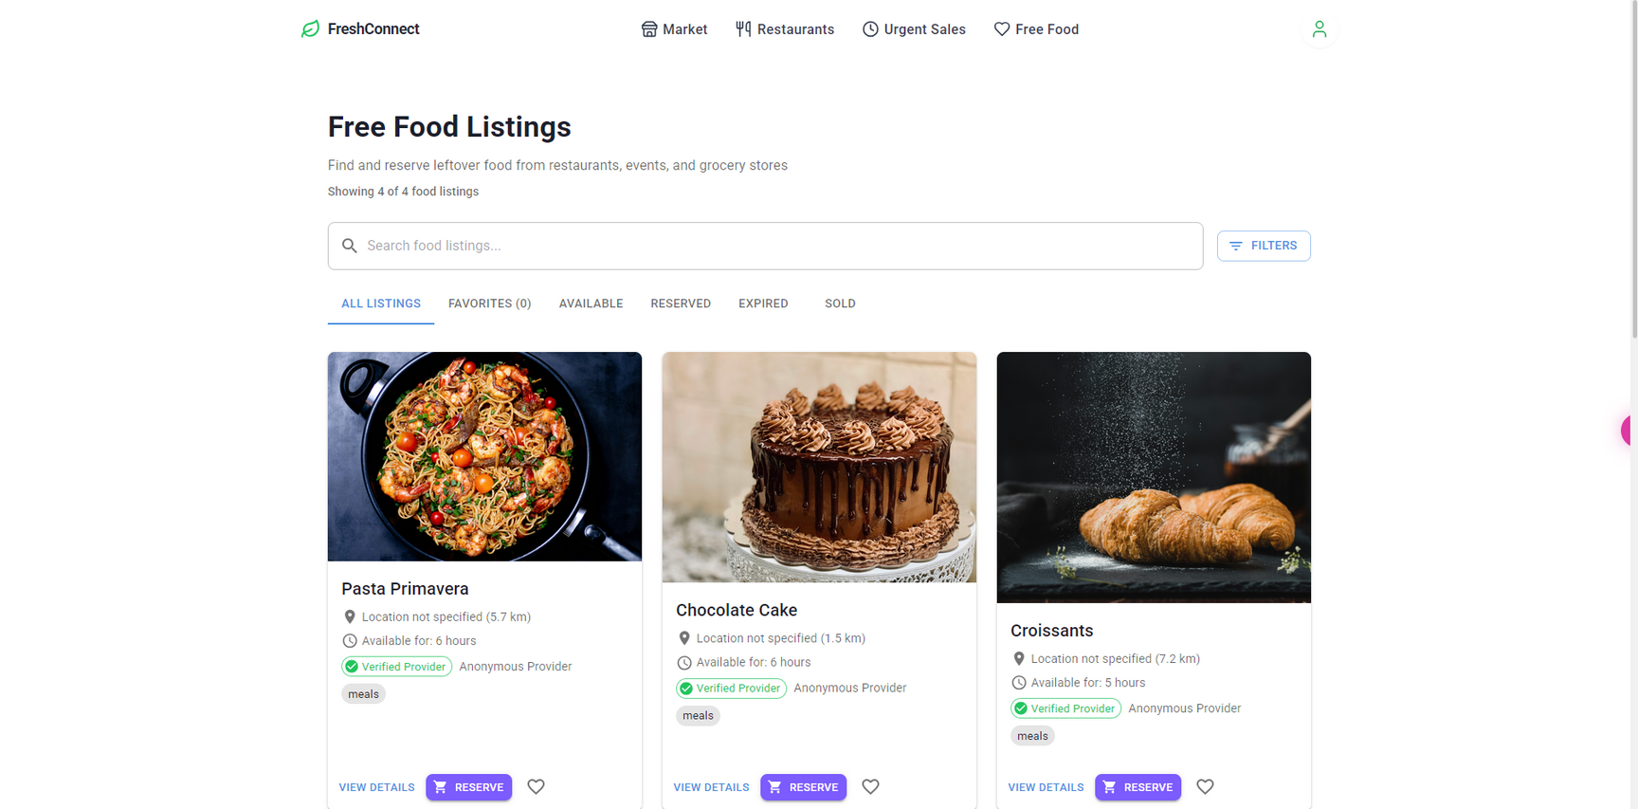

Slide 46
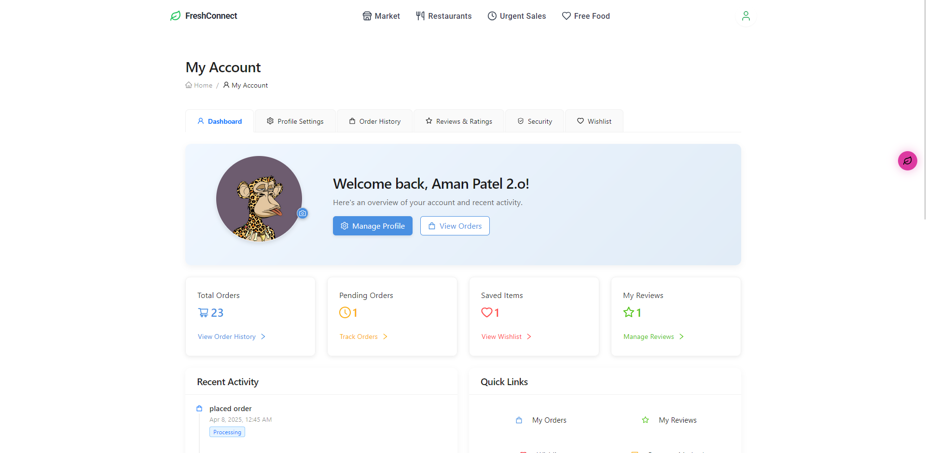

Slide 47
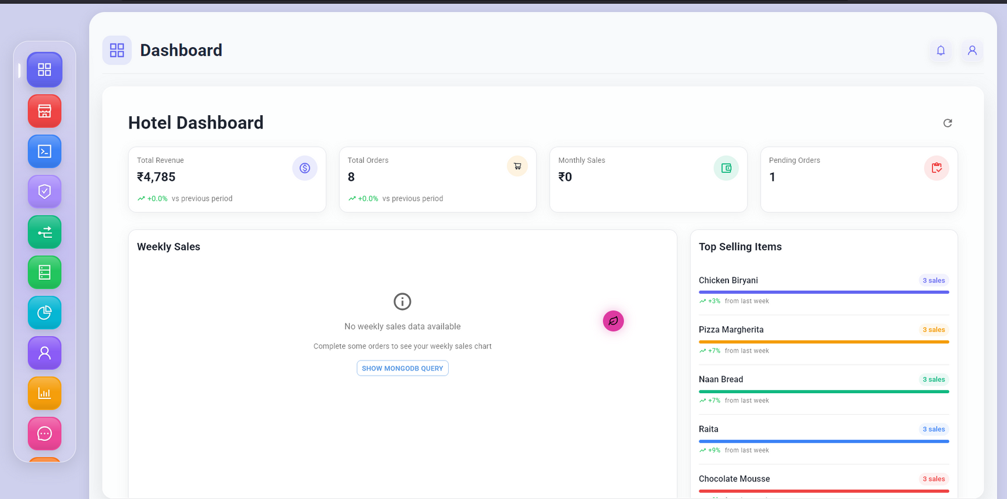

Slide 48
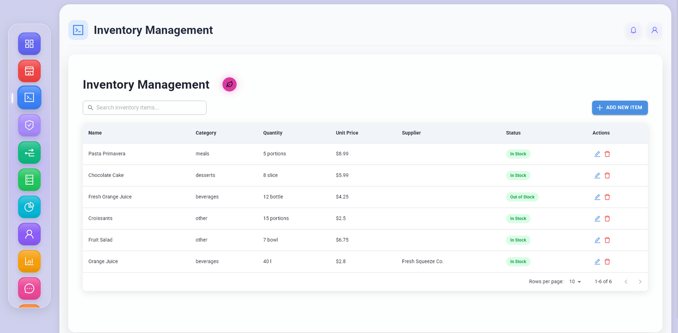

Slide 49
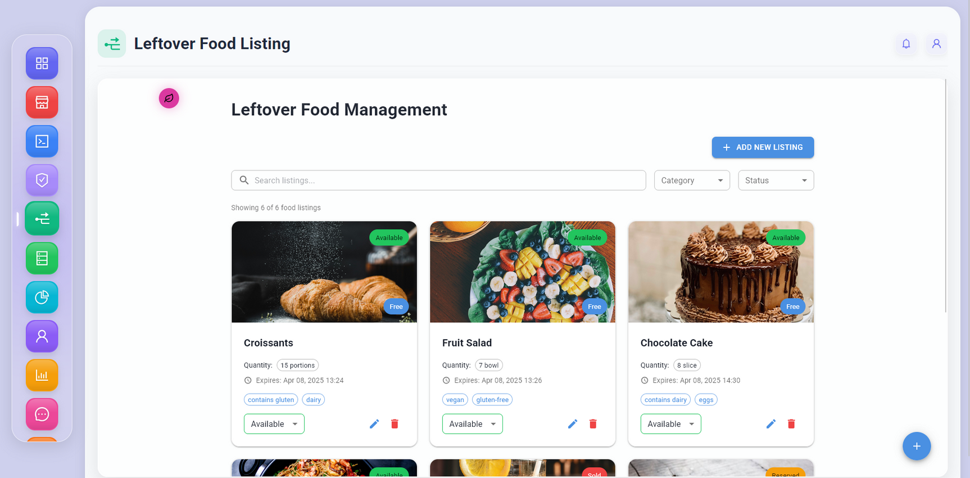

Slide 50
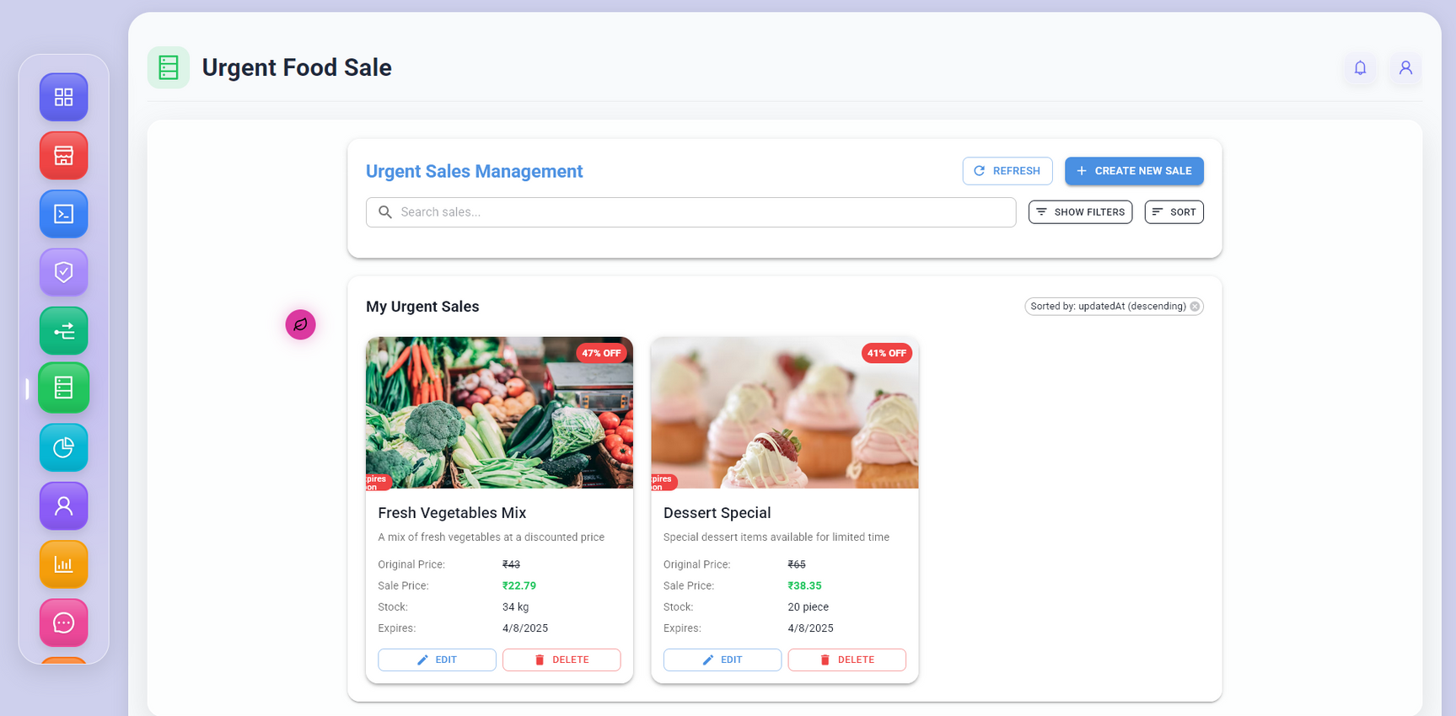

Slide 51
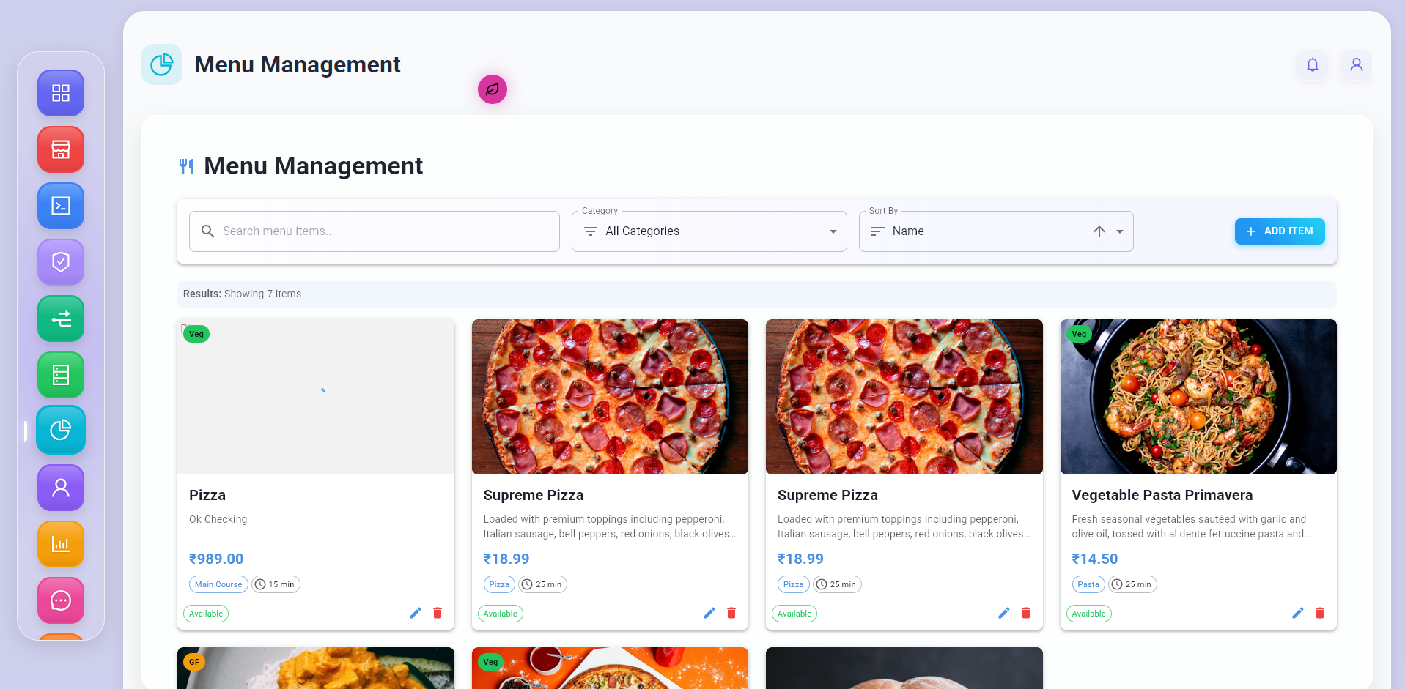

Slide 52
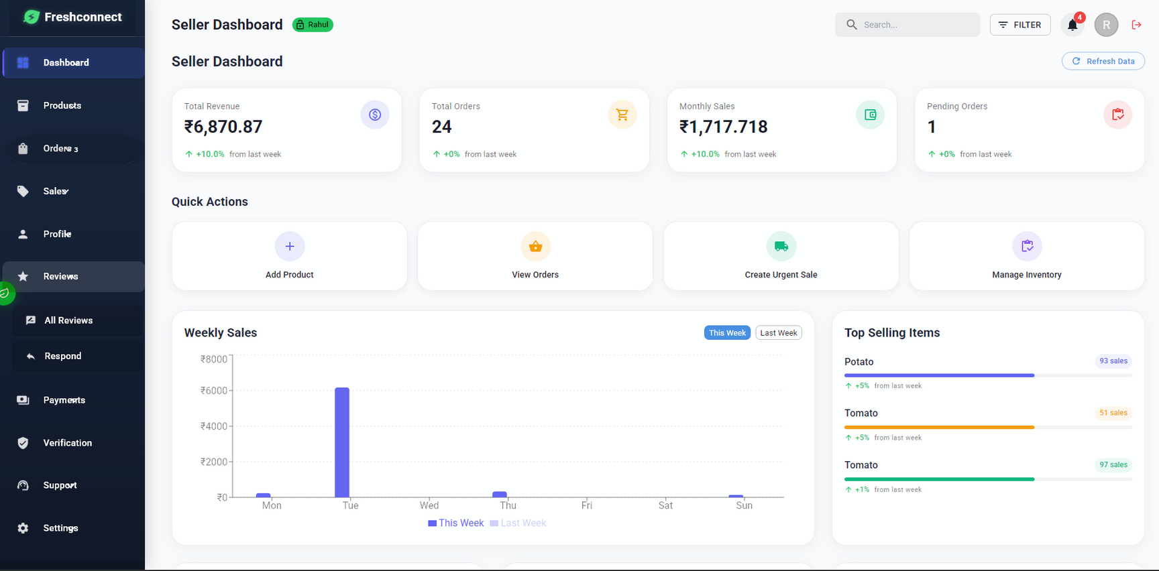

Slide 53
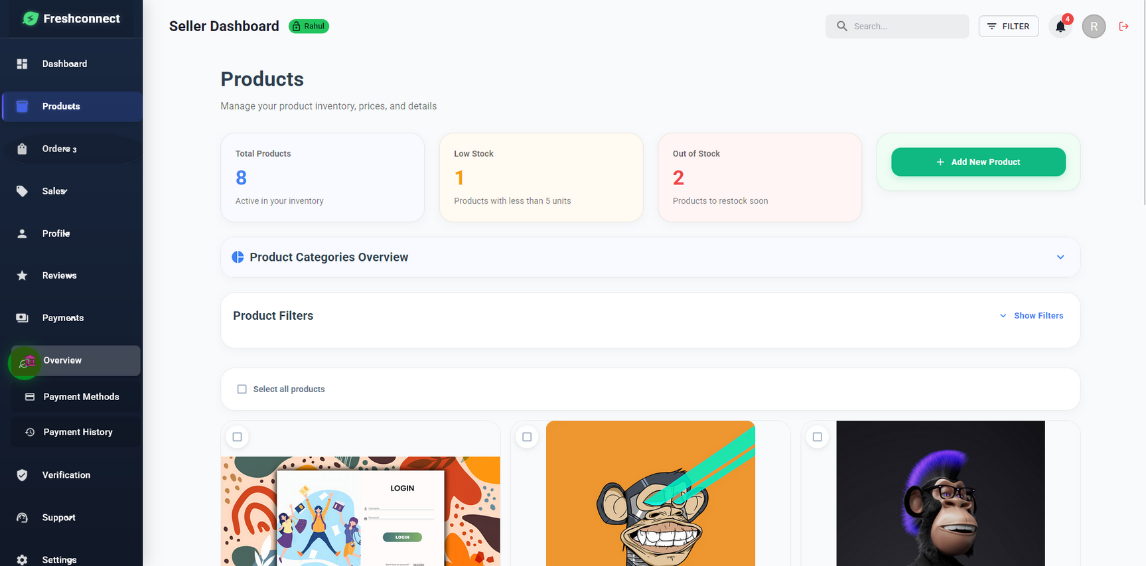

Slide 54
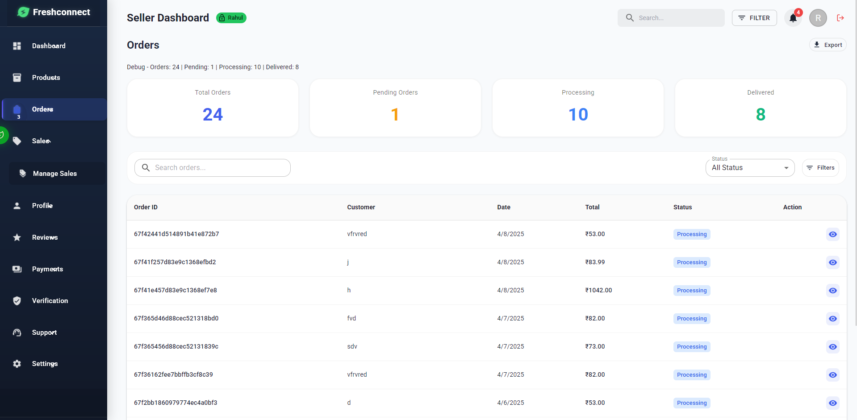

Slide 55
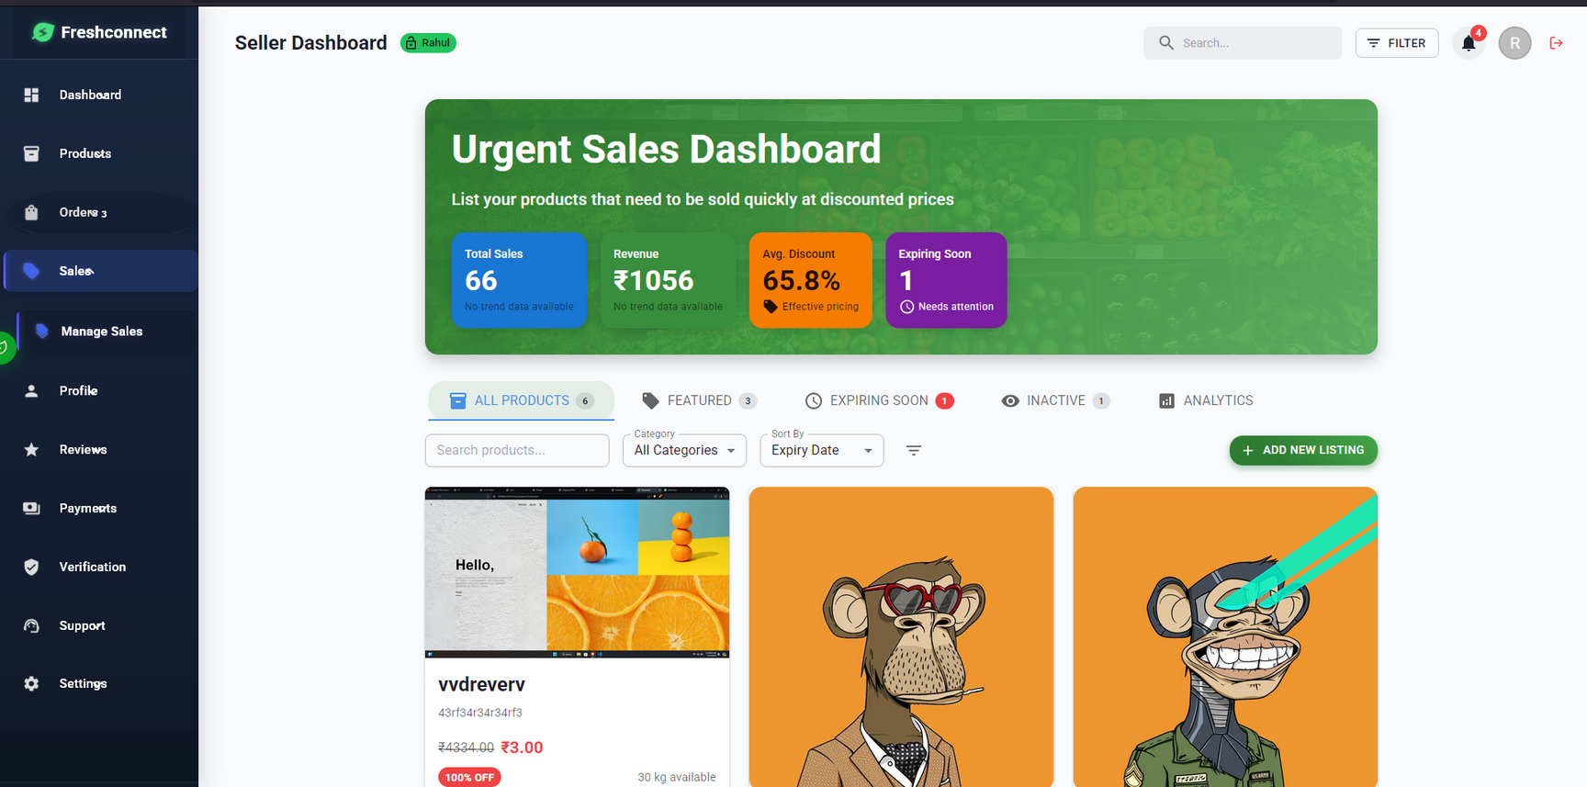

Slide 56
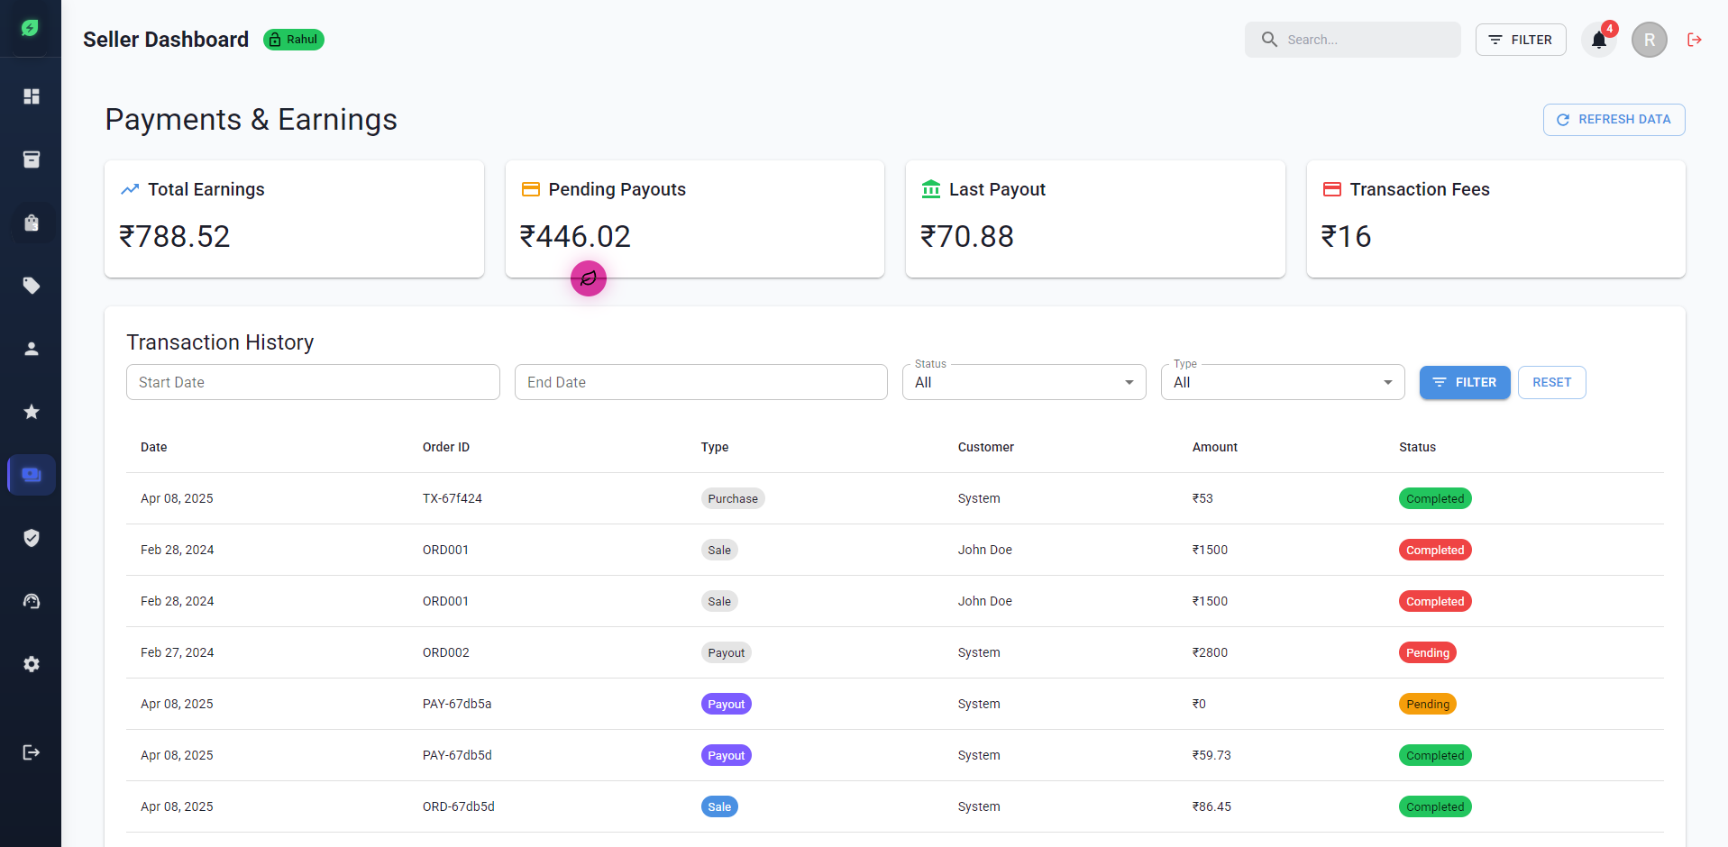

Slide 57
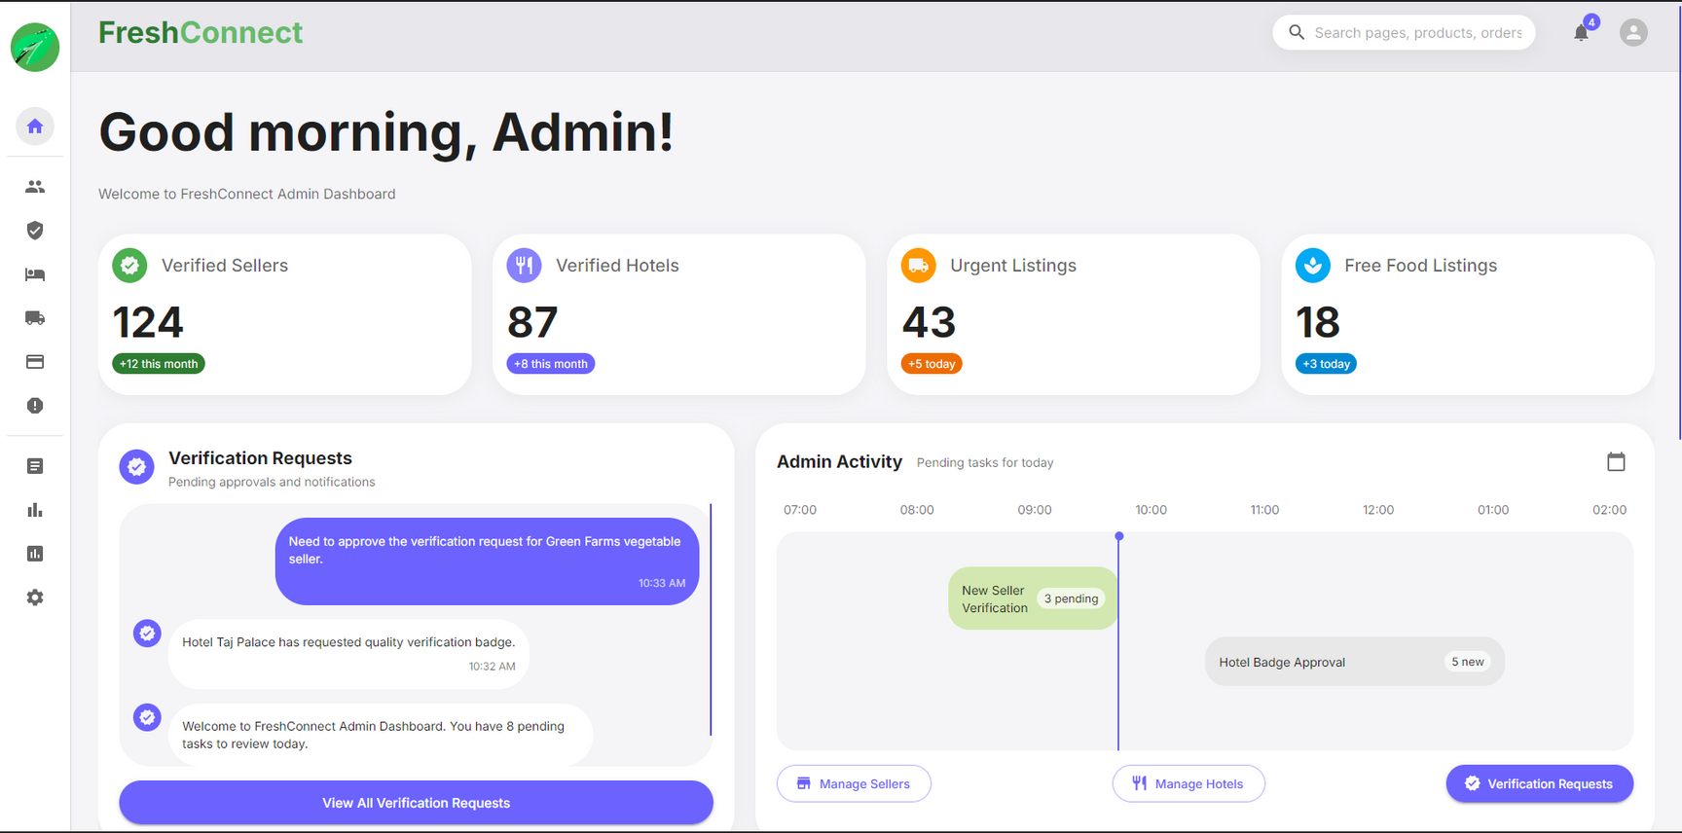

Slide 58
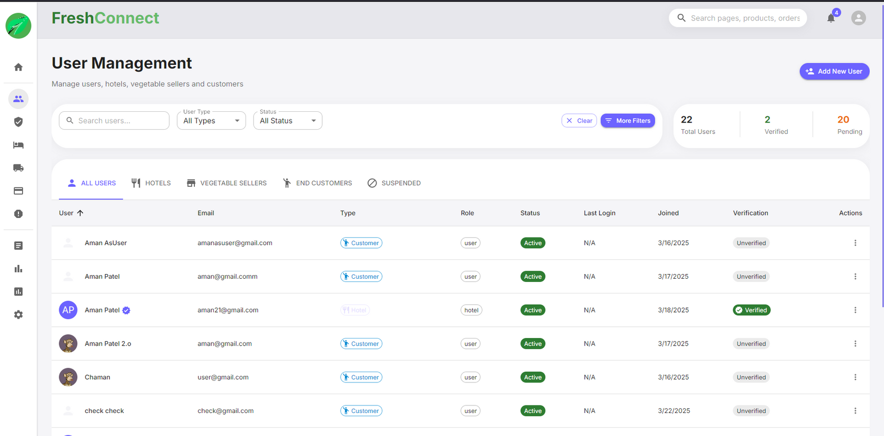

Slide 59
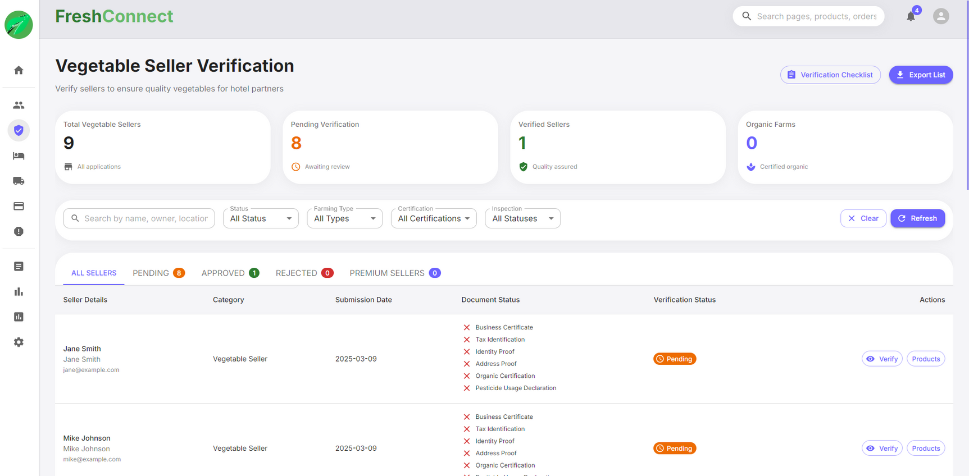

Slide 60
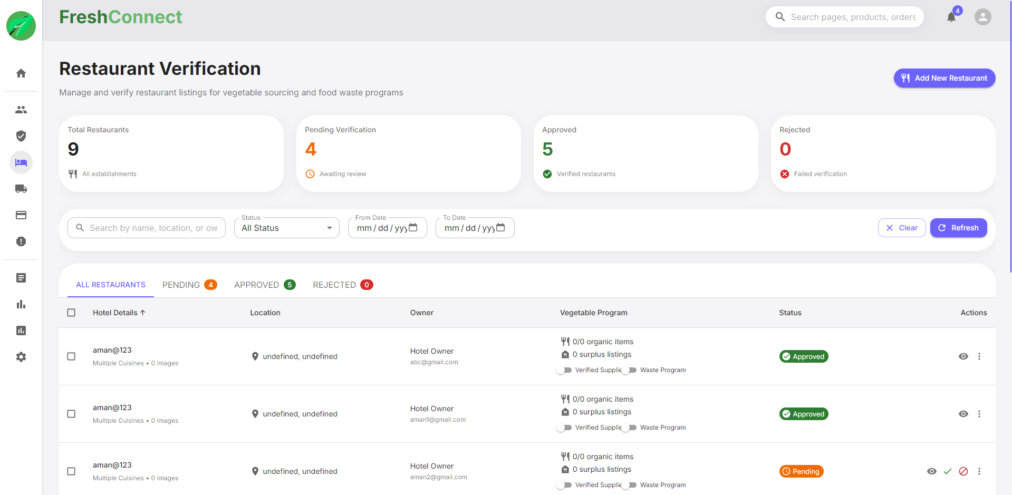

Slide 61
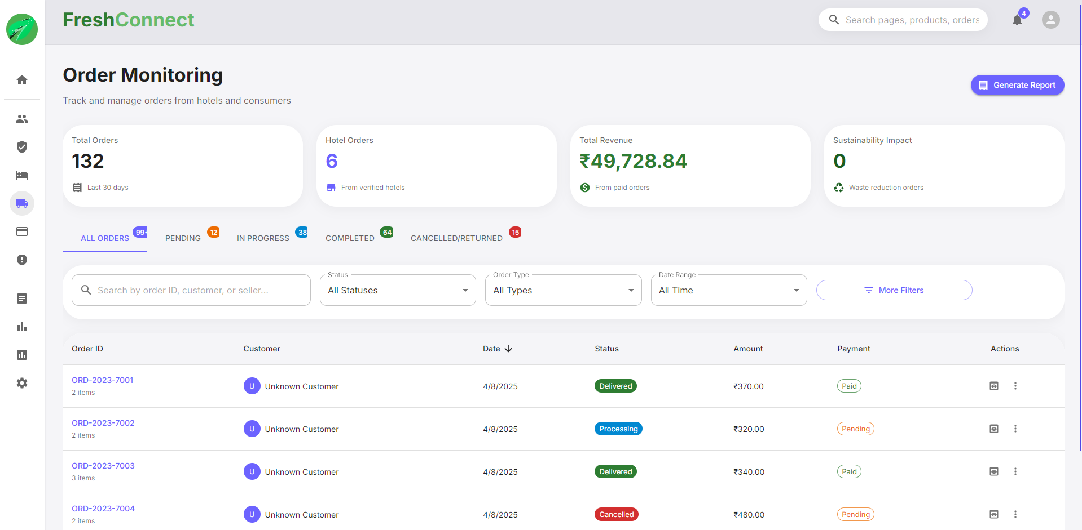

Slide 62
Refrence
Nodejs
Mongodb
Daigram
React
StackOverFlow
npmjs
http://www.youtube.com

